Slide 1


Department of Computer Science and Engineering
Building a Dyslexia Detection Web App with Boosting and Flask: A Step-by-Step Guide
ABDUR RAZAQ A - 211420104003
KARTHIKEYAN P - 211420104124
KIRUBHANIDHI M - 211420104133
Guide Name & Designation
Dr.T.HARIHARAN
Coordinator Name & Designation
Dr.G.SENTHILKUMAR

Slide 2
Introduction
This project focuses on leveraging a boosting algorithm for the development of a dyslexia detection model. Dyslexia, a widespread learning disorder, can benefit from machine learning solutions that employ boosting techniques. The project aims to create an effective model capable of accurately identifying dyslexia based on relevant features. The subsequent integration of this model into a Flask web application enhances accessibility, enabling users to receive real-time predictions and potentially contributing to early dyslexia identification.
The project scope encompasses the development of a Dyslexia Detection Web App using Boosting and Flask, aiming to create an accessible and accurate tool for identifying dyslexia. The scope includes implementing advanced Boosting algorithms, integrating Flask for web deployment, and providing a comprehensive guide for developers.

Slide 3
Objective of the Project
The objective of this comprehensive guide is to empower developers and enthusiasts to create a Dyslexia Detection Web App using Boosting techniques, offering a step-by-step roadmap for implementation. It aims to provide a hands-on experience in building a robust and effective tool for identifying dyslexia. Readers will gain insights into the intricacies of dyslexia detection, learn the fundamentals of Boosting algorithms, and acquire practical skills in using the algorithms and module packages.

Slide 4
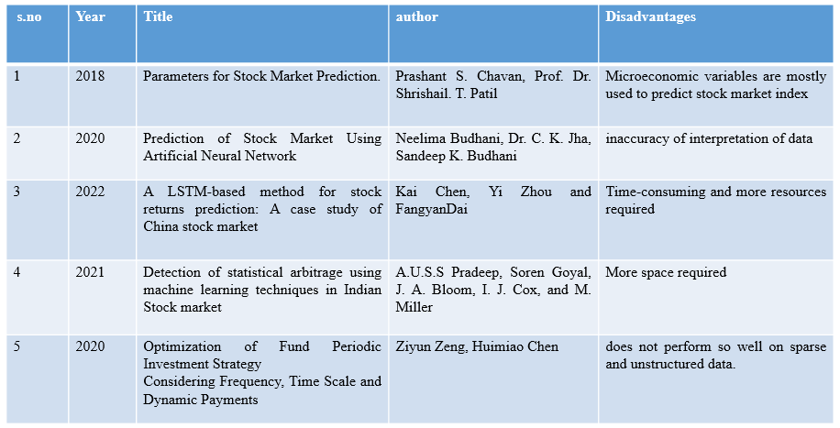
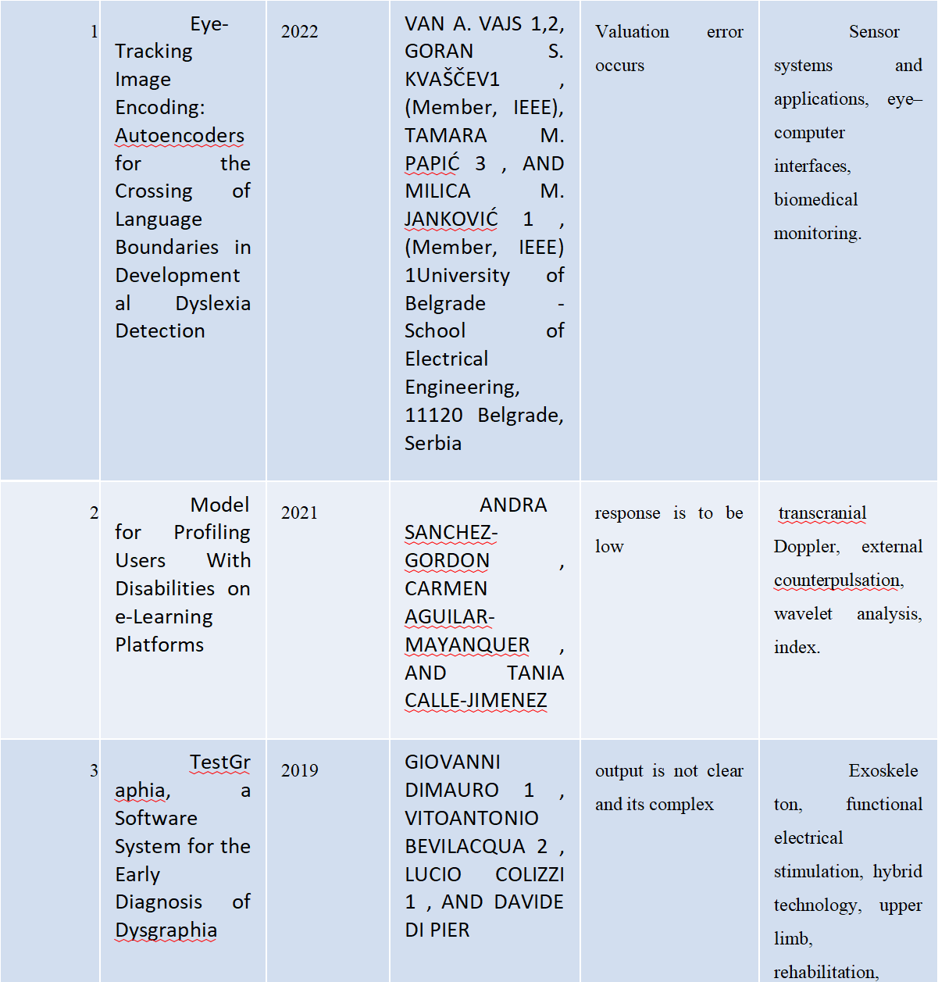
Literature Survey

Slide 5
Existing System
Traditionally, dyslexia detection involves educational assessments and psychological evaluations. While some researchers explore machine learning for this purpose, there isn't a standardized system yet. To find the latest information, it's advised to check recent research and open-source projects in relevant fields. Ethical considerations and stakeholder involvement are essential when developing solutions for learning disorders

Slide 6
Proposed System
The proposed system introduces a novel approach to dyslexia detection by incorporating a boosting algorithm, specifically designed to enhance accuracy and efficiency in comparison to conventional methods. This system leverages machine learning, utilizing the boosting algorithm's capabilities to automate the identification process. Real-time predictions are facilitated through a Flask web application, addressing subjectivity concerns and offering continuous monitoring. The system is designed to adapt to emerging technologies, ensuring a data-driven, accessible, and effective means of early dyslexia identification.

Slide 7
Software / Hardware used
Hardware:
Windows 7,8,10 64 bit
RAM 4GB
Software:
Python
Anaconda Navigator
Python built-in modules Python’s standard library
Pandas
Numpy
Sklearn
seaborn
matplotlib

Slide 8
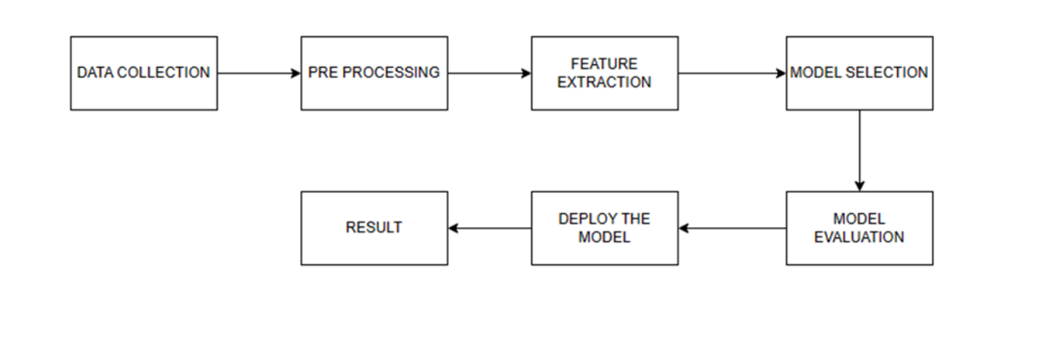
Architecture / Methodology used

Slide 9
Result & Discussion
In summary, the proposed dyslexia detection system, driven by a boosting algorithm in a Flask web application, offers efficient and accurate identification. With real-time predictions, continuous monitoring, and user-friendly features, it stands as a promising solution for early dyslexia detection. The system's scalability, adaptability, and privacy measures contribute to its potential to positively impact education and support for individuals with dyslexia.

Slide 10
Future Enchancement
Potential future enhancements for the Dyslexia Detection Web App could include integrating additional machine learning models for improved accuracy, incorporating user feedback mechanisms to continuously refine and adapt the algorithm, enhancing the user interface for a more intuitive experience, and exploring the integration of emerging technologies such as natural language processing or deep learning to further advance dyslexia detection capabilities. Additionally, ongoing research and collaboration with experts in dyslexia and related fields could contribute to refining the algorithm and expanding the app's effectiveness in real-world scenarios.

Slide 11
Reference Paper/ URL
.
1.A. Elnakib, A. Soliman, M. Nitzken, M. F. Casanova, G. Gimel’farb and A. El-Baz, "Magnetic resonance imaging findings for dyslexia: A review", J. Biomed. Nanotechnol., vol. 10, no. 10, pp. 2778-2805, Oct. 2014.
2.J. M. Fletcher et al., "Classification of learning disabilities: An evidence-based evaluation" in Identification of Learning Disabilities: Research to Practice, Washington, DC, USA:Erlbaum Associates Publishers, pp. 185-250, Jan. 2002.
3.P. Tamboer, H. C. M. Vorst, S. Ghebreab and H. S. Scholte, "Machine learning and dyslexia: Classification of individual structural neuro-imaging scans of students with and without dyslexia", NeuroImage: Clin., vol. 11, pp. 508-514, 2016.
4.S. O. Wajuihian, "Neurobiology of developmental dyslexia Part 1: A review of evidence from autopsy and structural neuro-imaging studies", Optometry Vis. Develop., vol. 43, no. 3, pp. 121-131, 2012.
5.S. O. Wajuihian and K. S. Naidoo, "Dyslexia: An overview", Afr. Vis. Eye Health, vol. 70, no. 2, pp. 89-98, Dec. 2011.

